Slide 1

AMAZON SALES ANALYSIS DASHBOARD
PREPARED BY
SHERIN SAMUEL

Slide 2
Dataset Overview
Order Status
Payment Mehods
Customer Locations
Product Categories
Order Quantities and Sales Revenue
Total Orders
120
Unique Customers
15
Time Period Covered
February 25, 2025 – April 1, 2025
Unique Products
10

Slide 3
Field Name | Description
Order ID | Unique identifier for each transaction
Date | Order date
Product | Name of the sold product
Category | Product category (e.g., Electronics, Books)
Price | Price per unit
Quantity | Number of items sold
Total Sales | Total revenue from the sale
Customer Name | Name of the customer
Customer Location | City or region of the customer
Payment Method | Mode of payment (e.g., Credit Card, PayPal)
Status | Order delivery status (Completed, Cancelled)

Slide 4
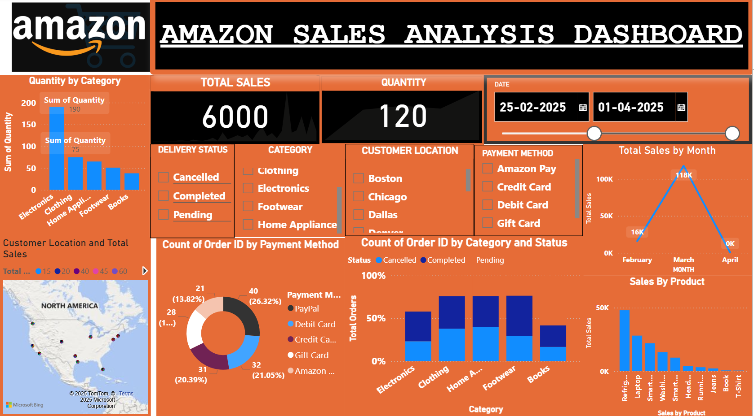

Slide 5
Total Sales Performance
Total Revenue: ₹6000
Total Quantity Sold: 120 units
Peak sales occurred in March 2025, contributing ₹118K.
Top Categories by Quantity Sold
Electronics – 190 units
Clothing – 75 units
Home Appliances (Other categories: Footwear, Books)
Top-Selling Products
Refrigerator
Laptop
Smartphone
Smartwatch
Regional Sales Highlights
Highest sales concentration in North American cities
Notable customer locations:
Boston
Chicago
Dallas
Denver
New York
Popular Payment Methods
PayPal – 40 orders (26.32%)
Debit Card – 32 orders (21.05%)
Credit Card – 31 orders (20.39%)
Amazon Pay and Gift Cards also used frequently
Recommendations
Improve delivery where Status = Cancelled
Boost high-selling products
Encourage preferred payment methods

Slide 6
THANK YOU

